Slide 1
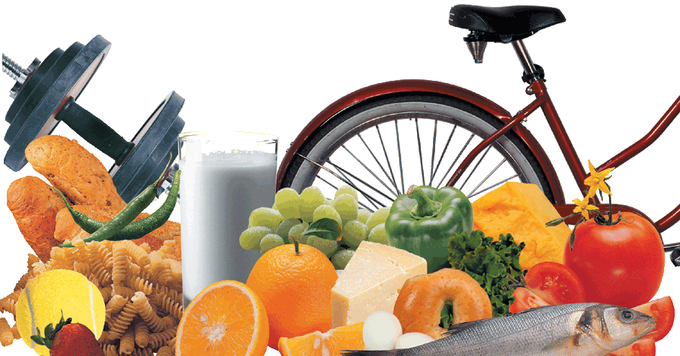
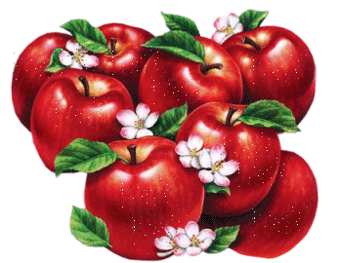


Slide 2
Health map
23 pupils of the 4th forms took part in the study
How often do you … ? | never | rarely | some- times | twice a day | every day
 | Number of pupils
eat fruit and vegetables |  | 1 | 1 |  | 21
eat sweets |  | 5 | 3 | 2 | 13
go for a walk |  |  | 3 | 3 | 17
play computer games |  | 4 | 3 | 3 | 13
do your morning exercises | 1 | 3 | 4 |  | 15
go to bed after 11 | 2 | 10 | 7 |  | 4
take a shower |  | 1 | 1 | 1 | 20
go to the swimming-pool | 5 | 6 | 7 | 2 | 2
do sports |  | 2 | 5 | 4 | 12
brush your teeth |  |  |  | 7 | 16

Slide 3
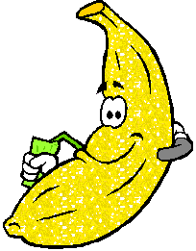

The results:
15 pupils are healthy
8 pupils are not very healthy

Slide 4
We’re going to…
speak about health problems
speak about healthy lifestyle
write a test
read about sports at our school
write out healthy rules
speak about school life
do exercises

Slide 5
Good health is above wealth
stop, drops, good, doctor
health, eat, beach, meat
ice, tidy, is, Friday
nose, above, rose, close
please, leaves, wealth, teacher

Slide 6
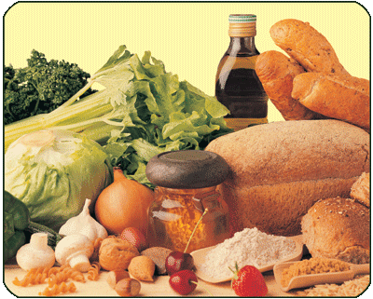
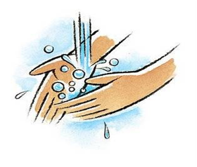

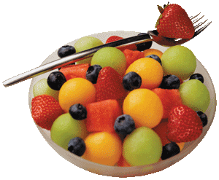

Keeping Fit
Healthy food
Healthy habits
Doing sports

Slide 7


Healthy Food
Food groups:
Fruit and Vegetables
Milk and Cheese
Meat and Fish
Bread and Cereal

Slide 8
It They | help(s) give(s) | your skin your body your teeth your bones to build your body you energy you vitamins no good no health

Slide 9
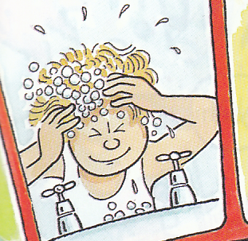
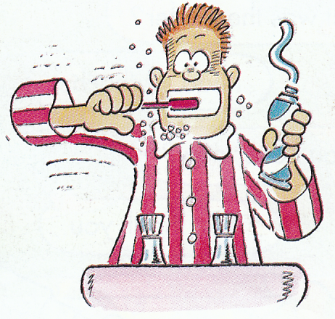
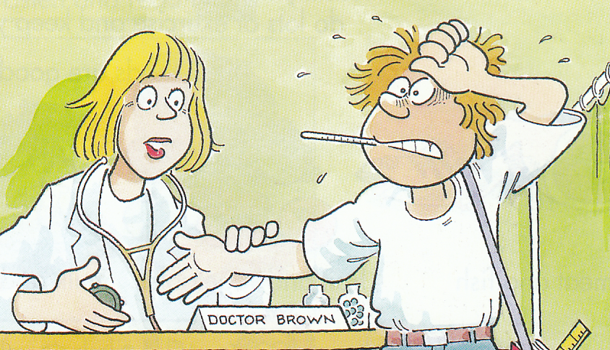
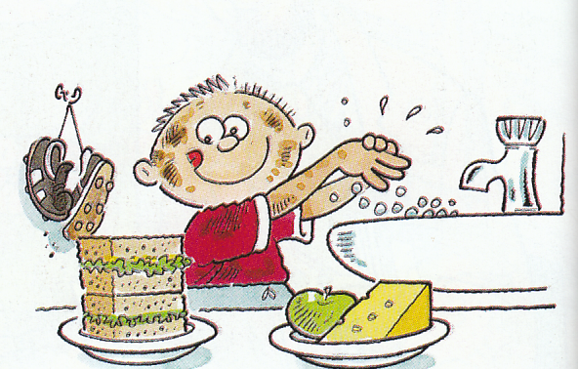

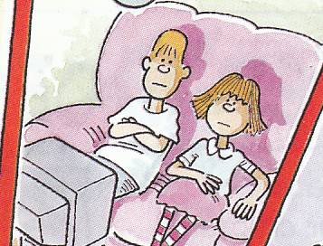
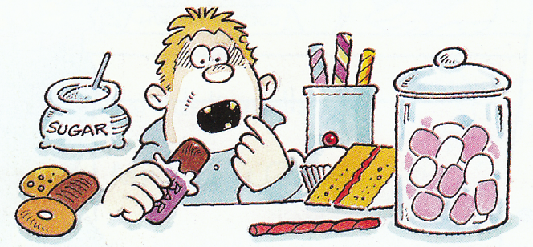
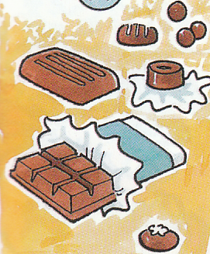
Healthy Habits
People should …
People shouldn’t …

Slide 10


Correct the mistakes:
Don’t eat many sweets.
Eat a lot of sweets.
Don’t eat fruit and vegetables.
Eat a lot of fat products.
Take a shower every week.
Play computer games every day.
Watch TV all night.
Eat a lot of fruit and vegetables.
Don’t eat many fat products.
Take a shower every day.
Don’t play computer games much.
Don’t watch TV all night.

Slide 11
What will you do to be healthy?
I will …
do morning exercises
play sports games
keep my body clean
eat different foods
eat more fruit and vegetables

